Slide 1
To do list web application presentation
By Andi Berisha

Slide 2
Introduction
About Me:
I’m Andi and I am a QA digital consultant trainee.
Approach:
Studied the project specification thoroughly.
Followed the back end video examples and tried to infer the function of the application based on its code architecture.
Used Stack Overflow and the trainers to deal with various errors and problems throughout the project.

Slide 3
MOSCOW
Must Haves: | Should Haves: | Could Haves: | Won’t Haves:
Full CRUD functionality | A search task function | Attach pictures to tasks | Log in features such as user log in and passwords.
Test Coverage of above 90% | Well organised back end and front end folders. | Be able to download and generate an excel file of all the todos. | Shared todo list functionality
Code with a fully integrated version control system. | Visually appealing UI | Sub tasks | Syncing with other social media platforms
A local relational database to persist data | Accessible on multiple devices | Project creation for each user | Emoji and other special character implementation.
To-do lists for multiple users |  | Undo delete task button | Reminder functionality
MVP achieved

Slide 4
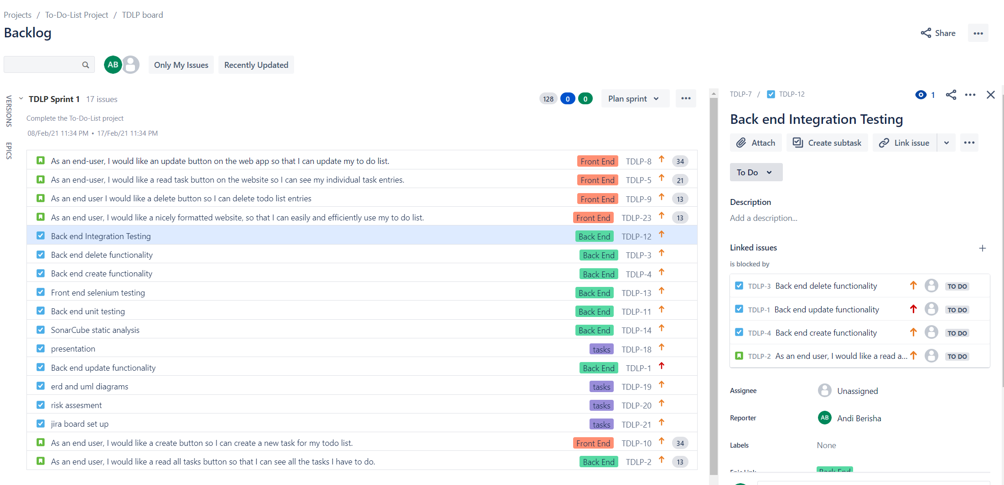
Sprint plan / User story backlog

Slide 5
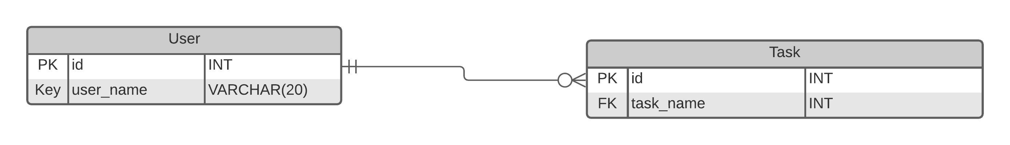
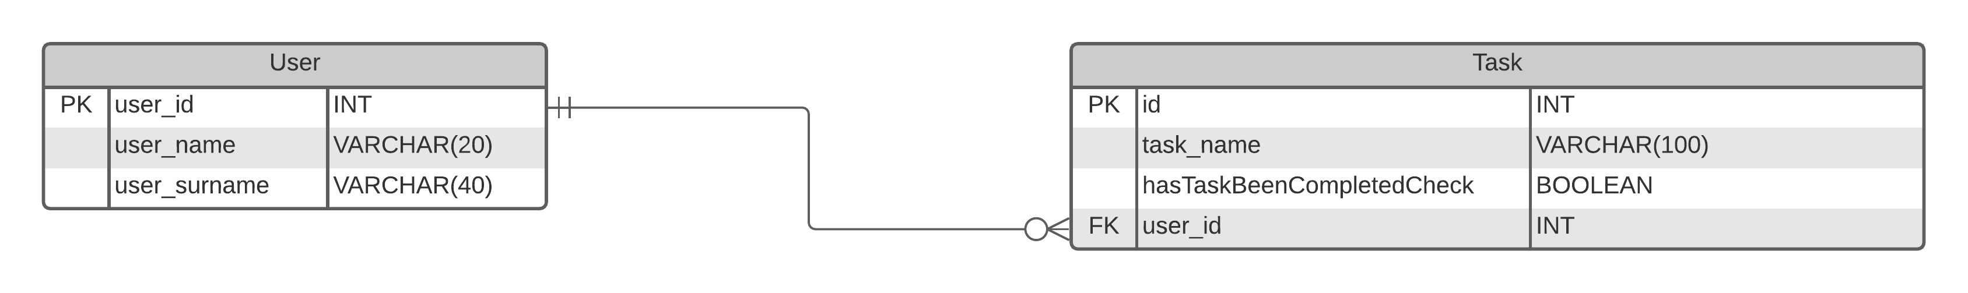
Entity relationship diagrams
Initial ERD
Final ERD

Slide 6
Consultant journey
Technologies employed for this project:
Version Control System: Git
Source Code Management: GitHub
Kanban Board: Jira
Database Management System: MySQL Server 5.7 (local)
Back-End Programming Language: Java
API Development Platform: Spring
Front-End Web Technologies: HTML, CSS, JavaScript
Build Tool: Maven
Static Analysis: SonarQube
Unit & Integration Testing: JUnit, Mockito
User-Acceptance Testing: Selenium

Slide 7
Continuous integration
Employed the feature-branch pattern in order to obtain a clear insight into the project progress and development.
Ensured no merge conflicts occurred by using the simplified Github in-browser pull request method.
Used various build tools through maven.
Made commits at least twice a day.

Slide 8
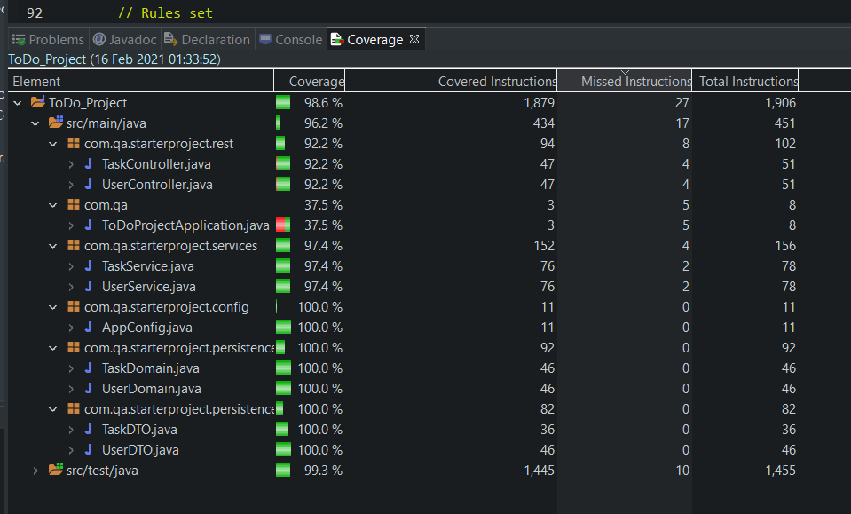
Unit and Integration testing

Slide 9
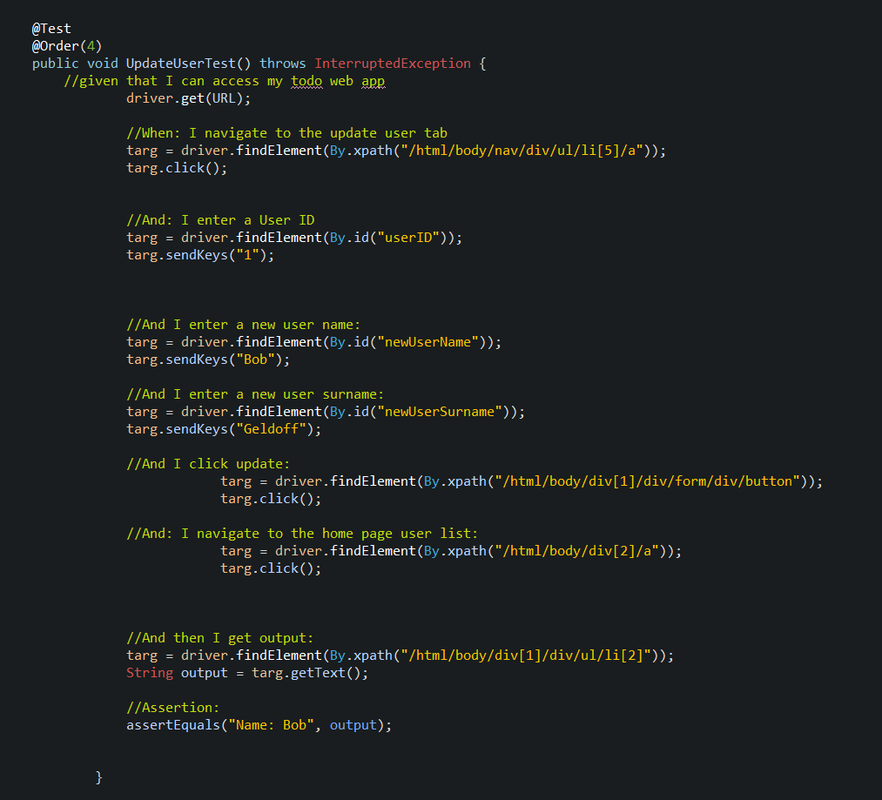
User Acceptance Testing (Selenium)

Slide 10
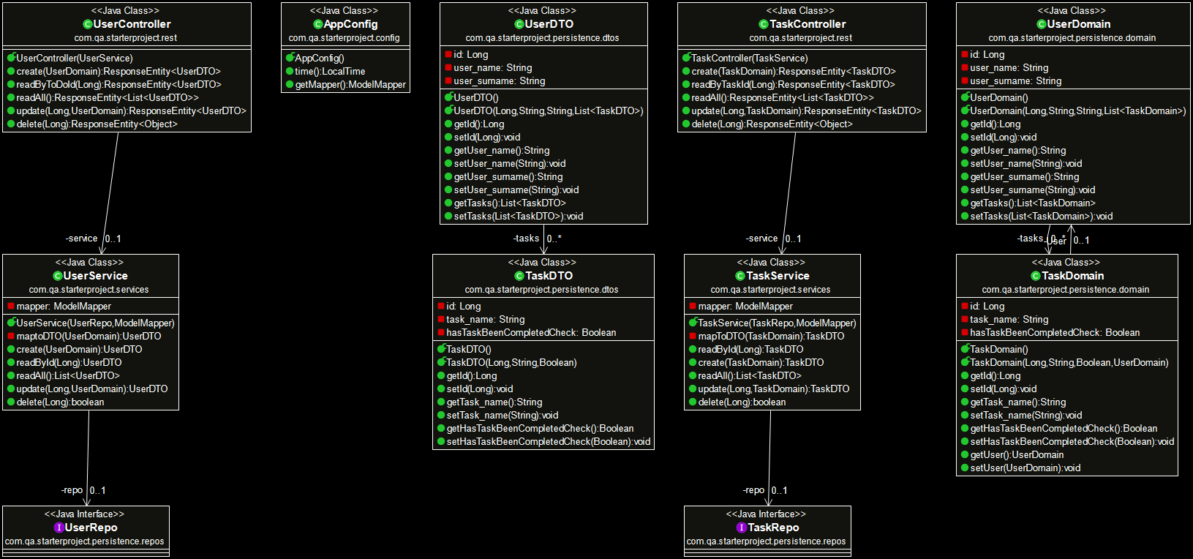
Uml diagram

Slide 11
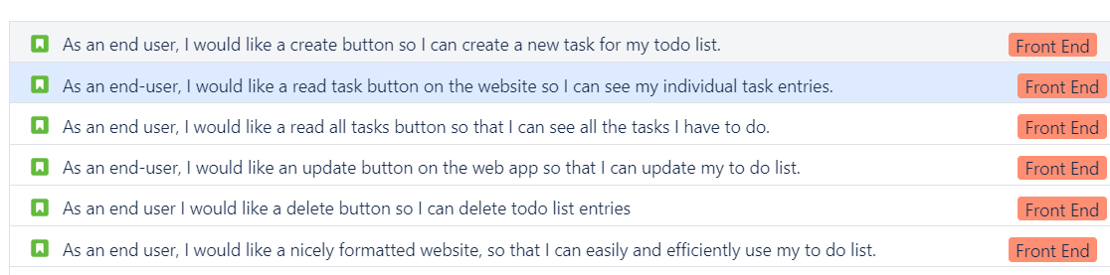
Demonstration

Slide 12
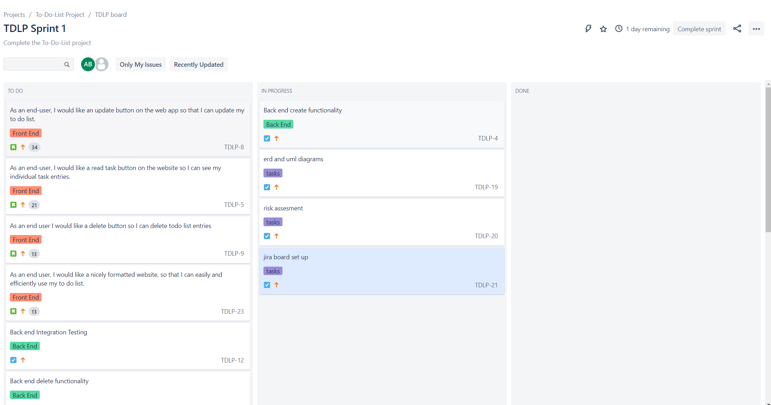
Start of sprint

Slide 13
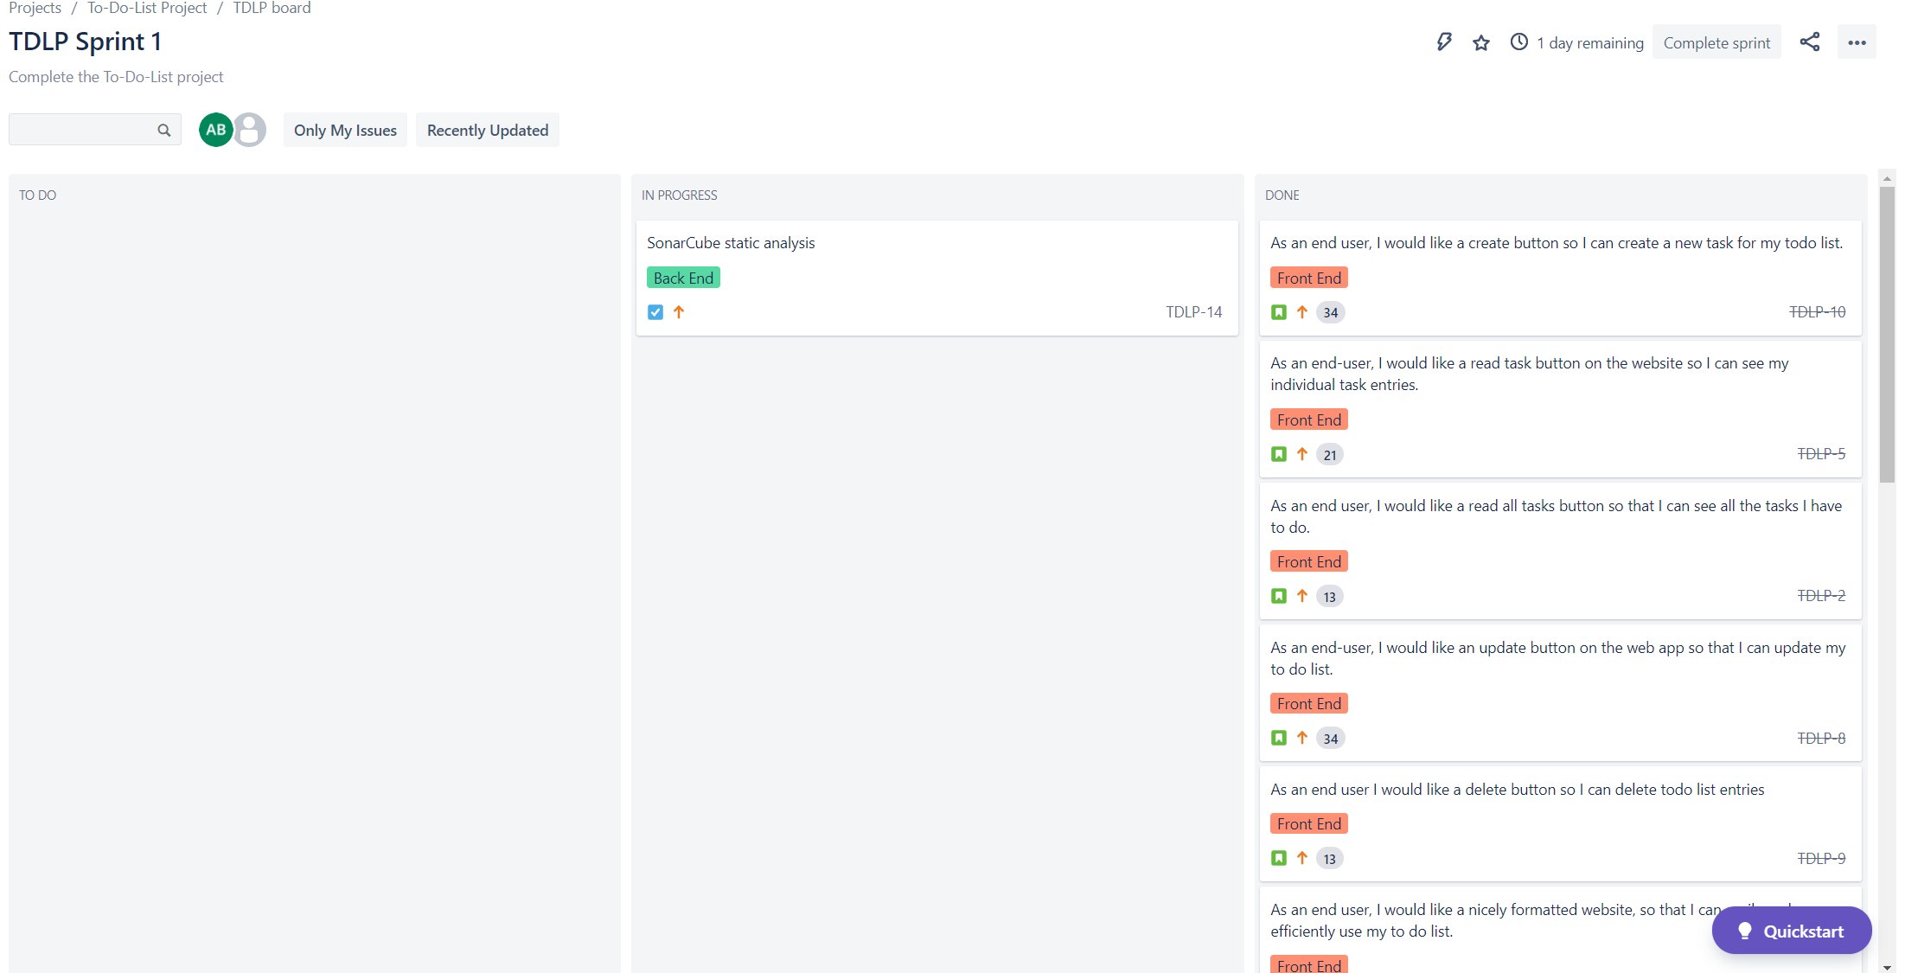
End of Sprint

Slide 14
Sprint Retrospective
What was well: | What went poorly:
MVP achieved, front end and back end work well together. | SonarQube currently left undone due to installation issues
Test coverage of 96% achieved | Front-end testing not rigorous enough
Selenium testing achieved | Search function was not able to be added due to time constraints
Web app can create to-do list for multiple users.
Git was implemented very well
Aesthetically pleasing application
Accessible on multiple devices

Slide 15
Conclusions
Project was successful (minimum viable product has been delivered)
Project enabled me to utilise all the knowledge from the last few weeks and truly get to grips with the syntax and class interactions.
Confidence slowly grew throughout the project.
Brilliant implementation of the integration and unit tests, with a test coverage above 95%.
Could have achieved a significantly better project quality if given a few more project days.
Will definitely continue to work on this project in the near future as I want to achieve a quality I am actually happy with.

Slide 16
Any Questions?

